Slide 1




Energy Consumption Trend Analysis with Power BI
- Empowering Smarter Energy Decisions with Analytics
Name: Rajamanikam A
Duration: Dec 2024 - Jan 2025
Organization: Edunet Foundation

Slide 2

Learning Objectives:
Understand energy consumption trends across various buildings and regions.
Identify key performance indicators (KPIs) to assess energy efficiency and identify areas for improvement.
Learn the end-to-end process of data analysis, from pre-processing to visualization.
Gain proficiency in Power BI for creating interactive dashboards.
Develop skills in data modeling and actionable insights generation.
GOAL

Slide 3


Tools and Technology Used:
Power BI: To create interactive dashboards and visualizations for energy consumption and cost analysis.
Microsoft Excel: For preliminary data cleaning, transformation, and exploration.
Operating System: Windows 10 or later / macOS 10.15 or later.
Dataset Used: Energy Consumptions Dataset.xlsx

Slide 4

Methodology:
Data Understanding: Review energy consumption dataset, including types and formats.
Data Pre-Processing
Cleaned data for consistency and accuracy.
Categorized and transformed data using Power BI tool.
Data Modeling
Established relationships between tables.
Created calculated measures using DAX.
Visualization: Designed interactive dashboards to showcase trends and anomalies.

Slide 5
Problem Statement:
Analyse daily energy consumption data for water, electricity, and gas across multiple buildings in different cities.
Identify high and low energy consuming buildings and regions.
Calculate total energy costs based on annual consumption for each energy type.
Provide visualizations to highlight trends, seasonal variations, and anomalies in energy consumption.
Predict future energy consumption trends using historical data.

Slide 6
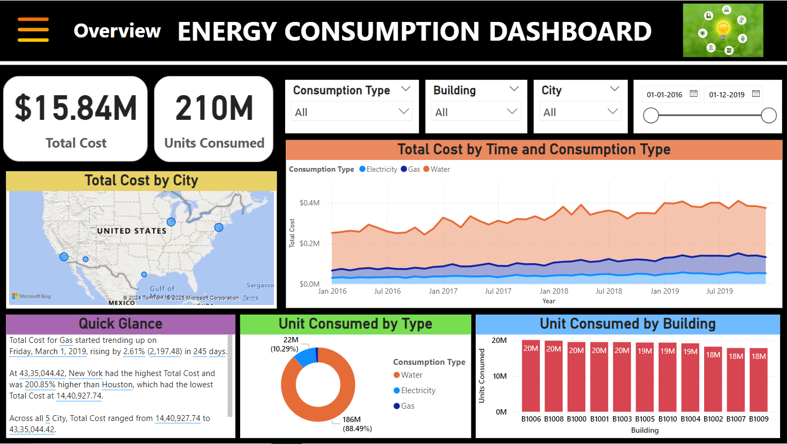
Solution:
As per our analysis, some of the key insights observed from our dashboard are of:
Total cost of all energy type consumption: $ 15.84 M
Total units consumed of all energy types combined: 210 M
Top 3 most energy consumed cities: New York, Los Angeles, Chicago
Most energy consumption is from renewable water-based sources, which contributes around 88.5 % with 186 M units consumed from year 2016-2019.
Top 5 highest energy consumed buildings: B1001, B1003, B1006, B1008, B1000
Recommendations:
Conduct energy audits in high-consumption areas
Upgrade house-hold equipment to energy-efficient alternatives (e.g., LED lights, HVAC systems).

Slide 7
Conclusion:
The project showcased the power of analytics in uncovering energy inefficiencies and optimization opportunities.
Highlighted high-consumption areas, seasonal trends, and cost-saving opportunities.
Skills Gained:
Developed expertise in data cleaning, modeling, and visualization using Power BI.
Learned to integrate tools like Excel and DAX to create meaningful insights.
Future Scope:
Integrate predictive analytics to forecast energy consumption and costs.
Expand analysis to include renewable energy adoption and ROI calculations.

Slide 8

Final Thought…
“This project not only improved energy management strategies but also emphasized the importance of sustainable practices powered by data analytics.”

